Slide 1
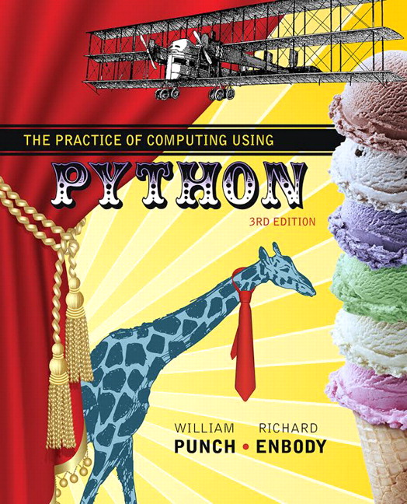
The Practice of Computing Using Python
Third Edition
Chapter7
Lists and Tuples
Copyright © 2017, 2013, 2011 Pearson Education, Inc. All Rights Reserved
Notes:
If this PowerPoint presentation contains mathematical equations, you may need to check that your computer has the following installed:
1) MathType Plugin
2) Math Player (free versions available)
3) NVDA Reader (free versions available)

Slide 2
Data Structures

Slide 3
Data Structures and algorithms
Part of the "science" in computer science is the design and use of data structures and algorithms
As you go on in CS, you will learn more and more about these two areas

Slide 4
Data Structures
Data structures are particular ways of storing data to make some operation easier or more efficient. That is, they are tuned for certain tasks
Data structures are suited to solving certain problems, and they are often associated with algorithms.

Slide 5
Kinds of data structures
Roughly two kinds of data structures:
built-in data structures, data structures that are so common as to be provided by default
user-defined data structures (classes in object oriented programming) that are designed for a particular task

Slide 6
Python built in data structures
Python comes with a general set of built in data structures:
lists
tuples
string
dictionaries
sets
others...

Slide 7
Lists

Slide 8
The Python List Data Structure
a list is an ordered sequence of items.
you have seen such a sequence before in a string. A string is just a particular kind of list (what kind)?

Slide 9
Make a List (1 of 2)
Like all data structures, lists have a constructor, named the same as the data structure. It takes an iterable data structure and adds each item to the list
It also has a shortcut, the use of square brackets [ ] to indicate explicit items.

Slide 10
Make a List (2 of 2)

Slide 11
Similarities with Strings
concatenate/+ (but only of lists)
repeat/*
indexing (the [ ] operator)
slicing ([:])
membership (the in operator)
len (the length operator)

Slide 12
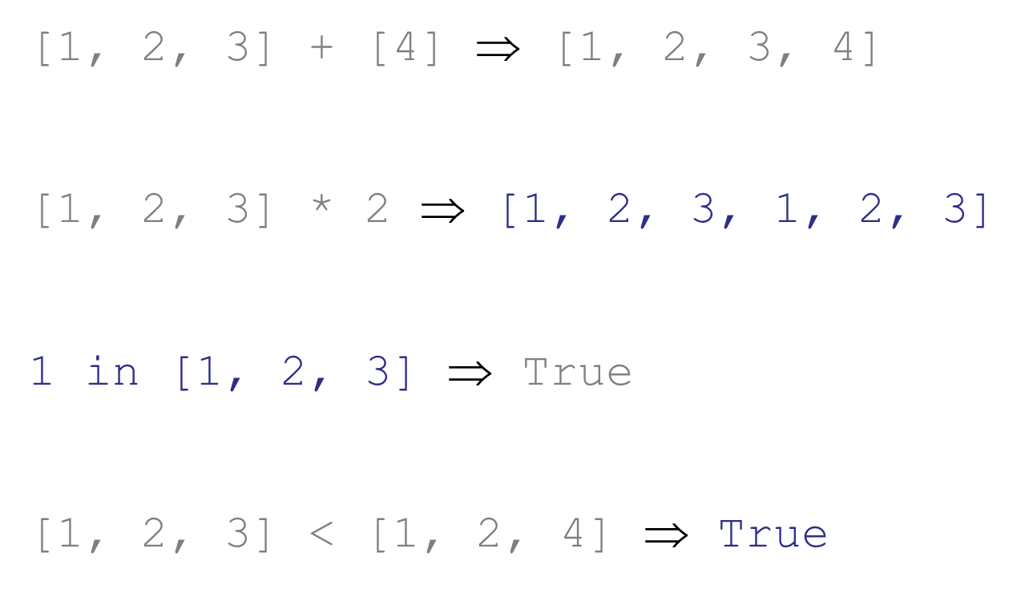
Operators
compare index to index, first difference determines the result

Slide 13
Differences Between Lists and Strings
lists can contain a mixture of any python object, strings can only hold characters
1, “bill”,1.2345, True
lists are mutable, their values can be changed, while strings are immutable
lists are designated with [ ], with elements separated by commas, strings use “ ”or ' '

Slide 14
Figure 7.1 The Structure of a list

Slide 15
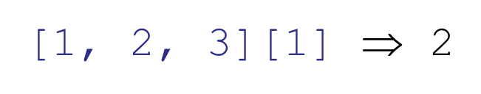
Indexing
can be a little confusing, what does the [ ] mean, a list or an index?
Context solves the problem. Index always comes at the end of an expression, and is preceded by something (a variable, a sequence)

Slide 16
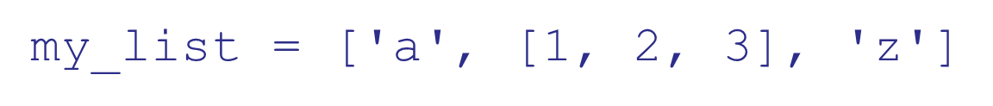
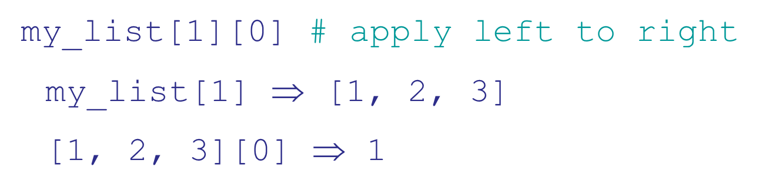
List of Lists
What is the second element (index 1) of that list? Another list.

Slide 17
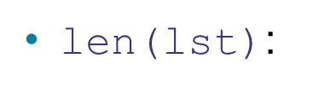
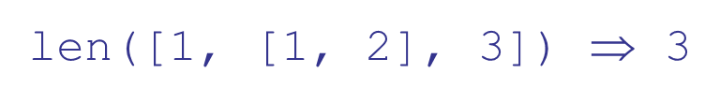
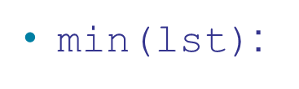
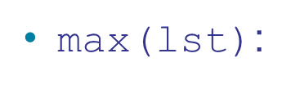
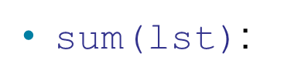
List Functions
number of elements in list (top level).
smallest element. Must all be the same type!
largest element, again all must be the same type
sum of the elements, numeric only

Slide 18
Iteration
You can iterate through the elements of a list like you did with a string:

Slide 19
Mutable

Slide 20
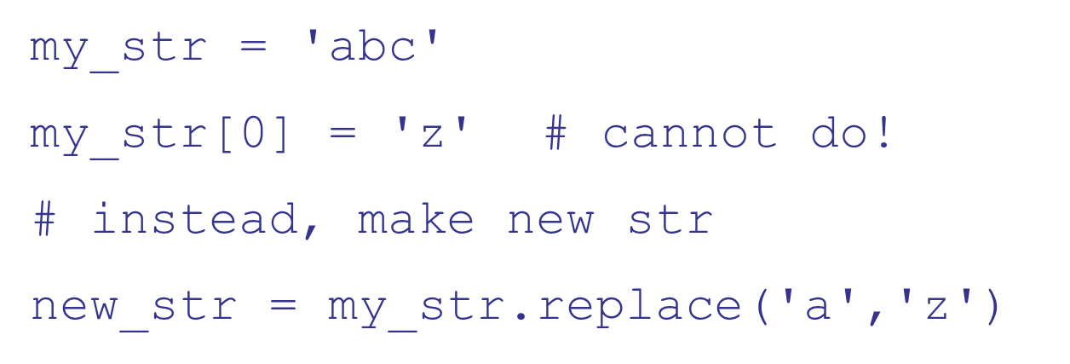
Change an object's Contents
strings are immutable. Once created, the object's contents cannot be changed. New objects can be created to reflect a change, but the object itself cannot be changed

Slide 21
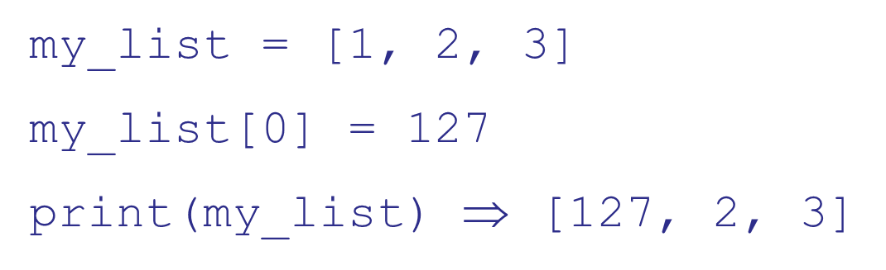
Lists are Mutable
Unlike strings, lists are mutable. You can change the object's contents!

Slide 22
List methods
Remember, a function is a small program (such as len) that takes some arguments, the stuff in the parenthesis, and returns some value
a method is a function called in a special way, the dot call. It is called in the context of an object (or a variable associated with an object)

Slide 23
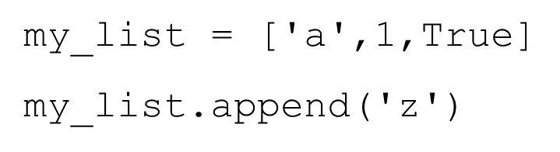
Again, Lists Have Methods
arguments to
the method
the object that
we are calling the
method with
the name of
the method

Slide 24
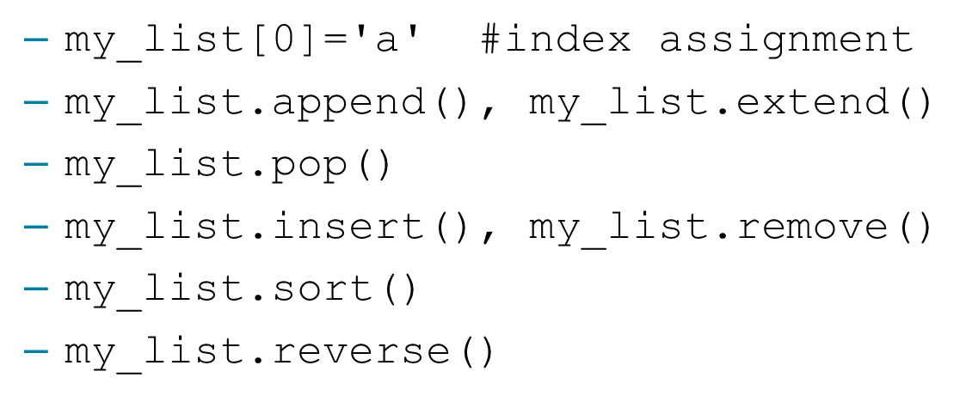
Some New Methods
A list is mutable and can change:

Slide 25
More About List Methods
most of these methods do not return a value
This is because lists are mutable, so the methods modify the list directly. No need to return anything.
Can be confusing

Slide 26
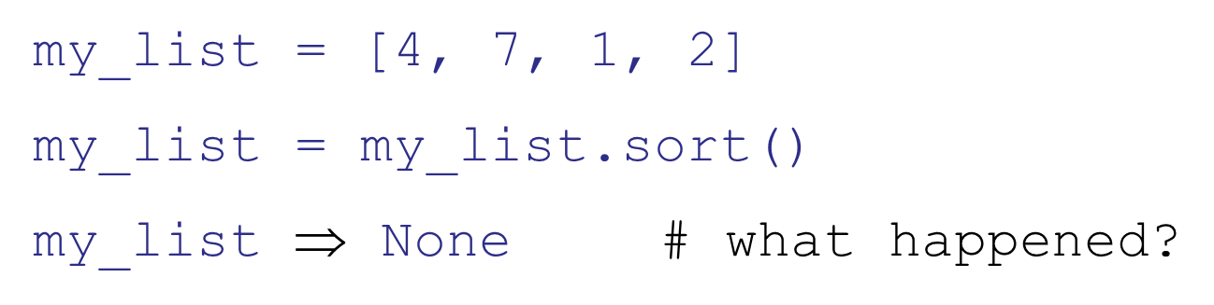
Unusual Results
What happened was the sort operation changed the order of the list in place (right side of assignment). Then the sort method returned None, which was assigned to the variable. The list was lost and None is now the value of the variable.

Slide 27
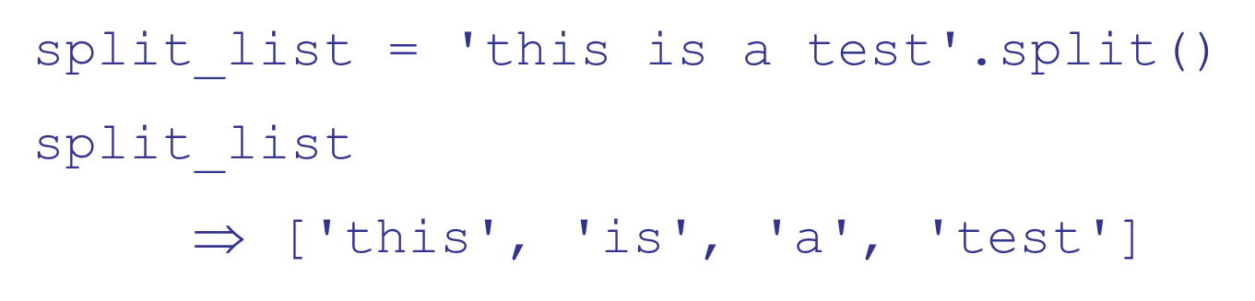
Split
The string method split generates a sequence of characters by splitting the string at certain split-characters.
It returns a list (we didn't mention that before)

Slide 28
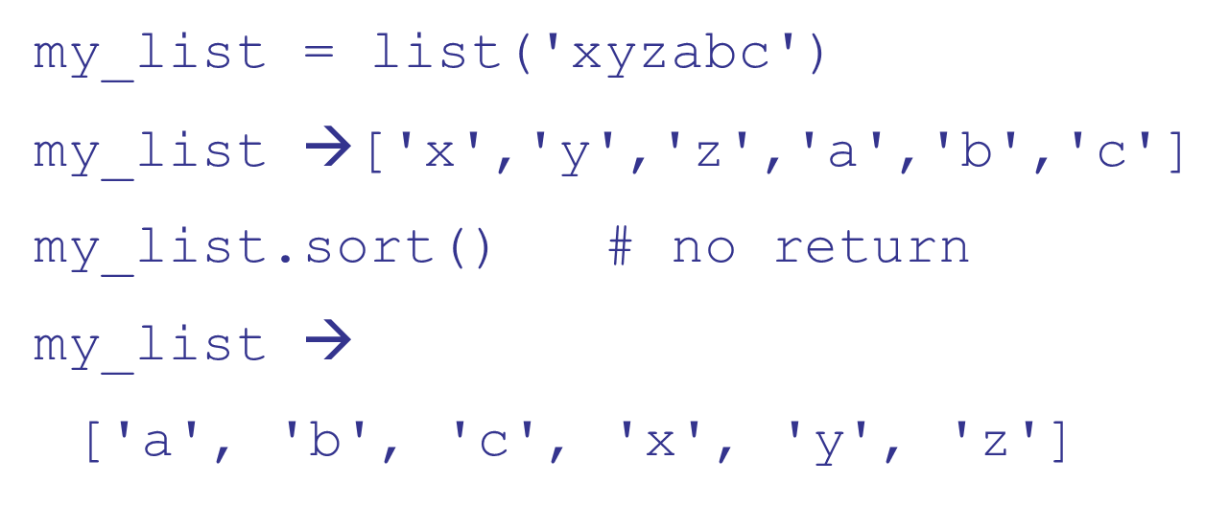
Sorting
Only lists have a built in sorting method. Thus you often convert your data to a list if it needs sorting

Slide 29
Reverse Words in a String
join method of string places the calling string between every element of a list

Slide 30
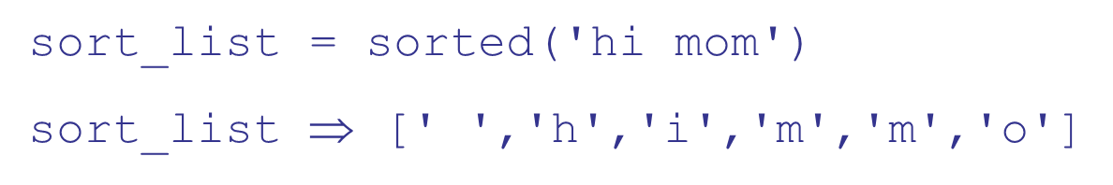
Sorted function
The sorted function will break a sequence into elements and sort the sequence, placing the results in a list

Slide 31
Some Examples

Slide 32
Anagram example
Anagrams are words that contain the same letters arranged in a different order. For example: 'iceman' and 'cinema'
Strategy to identify anagrams is to take the letters of a word, sort those letters, than compare the sorted sequences. Anagrams should have the same sorted sequence

Slide 33
Code Listing 7.1

Slide 34
Code Listing 7.3 Full Program

Slide 35
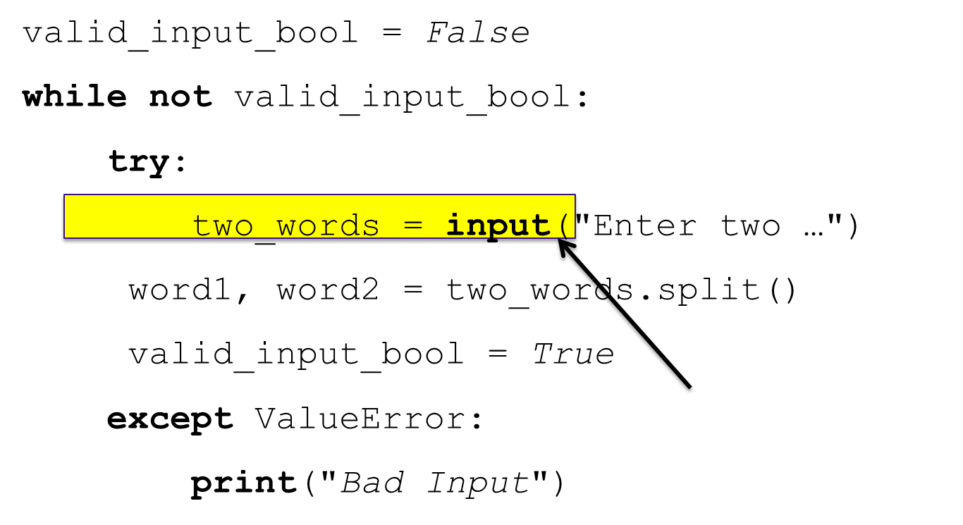
Repeat Input Prompt for Valid Input
only runs when no error,
otherwise go around again

Slide 36
Code Listing 7.4 Check those errors

Slide 37
Code Listing 7.5 Words from text file

Slide 38
Code Listing 7.7 Unique Words, Gettysburg Address (1 of 2)

Slide 39
Code Listing 7.7 Unique Words, Gettysburg Address (2 of 2)

Slide 40
More about mutables

Slide 41
Reminder, assignment
Assignment takes an object (the final object after all operations) from the RHS and associates it with a variable on the left hand side
When you assign one variable to another, you share the association with the same object

Slide 42
Figure 7.2 Namespace Snapshot #1

Slide 43
Immutables
Object sharing, two variables associated with the same object, is not a problem since the object cannot be changed
Any changes that occur generate a new object.

Slide 44
Figure 7.3 Modification of a Reference to an Immutable Object

Slide 45
Mutability
If two variables associate with the same object, then both reflect any change to that object

Slide 46
Figure 7.4 Namespace Snapshot after Assigning Mutable Objects

Slide 47
Figure 7.5 Modification of Shared, Mutable Objects

Slide 48
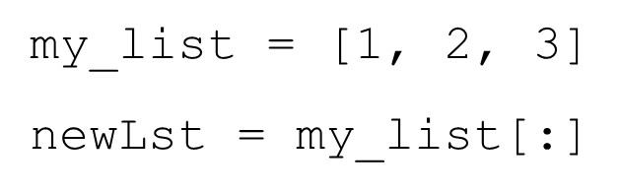
Copying
If we copy, does that solve the problem?

Slide 49
Figure 7.6 Making a Distinct Copy of a Mutable Object

Slide 50
Sort_of/depends
The big question is, what gets copied?
What actually gets copied is the top level reference. If the list has nested lists or uses other associations, the association gets copied. This is termed a shallow copy.

Slide 51
Figure 7.7 Self-Referencing

Slide 52
Figure 7.8 Simple Lists Before Append

Slide 53
Figure 7.9 Lists After Append

Slide 54
Figure 7.10 Final State of Copying Example

Slide 55
Shallow Versus Deep
Regular copy, the [:] approach, only copies the top level reference/association
if you want a full copy, you can use deepcopy

Slide 56
Figure 7.12 Using the Copy Module for a Deep Copy

Slide 57
Tuples

Slide 58
Tuples
Tuples are simply immutable lists
They are printed with (,)

Slide 59
The Question is, Why?
The real question is, why have an immutable list, a tuple, as a separate type?
An immutable list gives you a data structure with some integrity, some permanent-ness if you will
You know you cannot accidentally change one.

Slide 60
Lists and Tuple
Everything that works with a list works with a tuple except methods that modify the tuple
Thus indexing, slicing, len, print all work as expected
However, none of the mutable methods work: append, extend, del

Slide 61
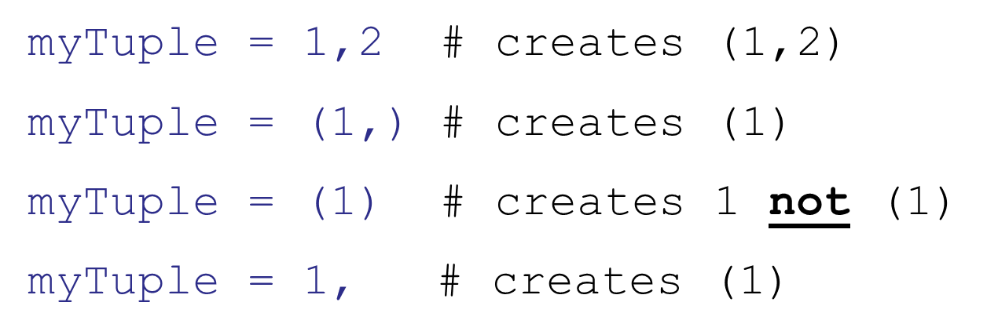
Commas Make a Tuple
For tuples, you can think of a comma as the operator that makes a tuple, where the ( ) simply acts as a grouping:

Slide 62
Data Structures in General

Slide 63
Organization of data
We have seen strings, lists and tuples so far
Each is an organization of data that is useful for some things, not as useful for others.

Slide 64
A good data structure
Efficient with respect to us (some algorithm)
Efficient with respect to the amount of space used
Efficient with respect to the time it takes to perform some operations

Slide 65
EPA Example

Slide 66
List Comprehensions

Slide 67
Lists are a Big Deal!
The use of lists in Python is a major part of its power
Lists are very useful and can be used to accomplish many tasks
Therefore Python provides some pretty powerful support to make common list tasks easier

Slide 68
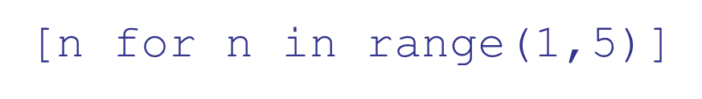
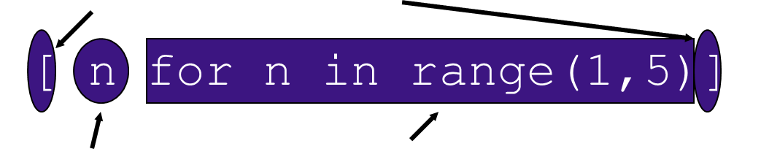
Constructing lists
One way is a "list comprehension"
mark the comp with [ ]
returns
[1,2,3,4]
what we iterate
through. Note that
we iterate over a set of
values and collect some
(in this case all) of them
what we
collect

Slide 69
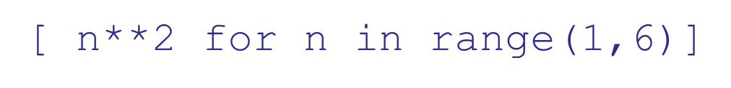
Modifying What We Collect
returns [1,4,9,16,25]. Note that we can only change the values we are iterating over, in this case n

Slide 70
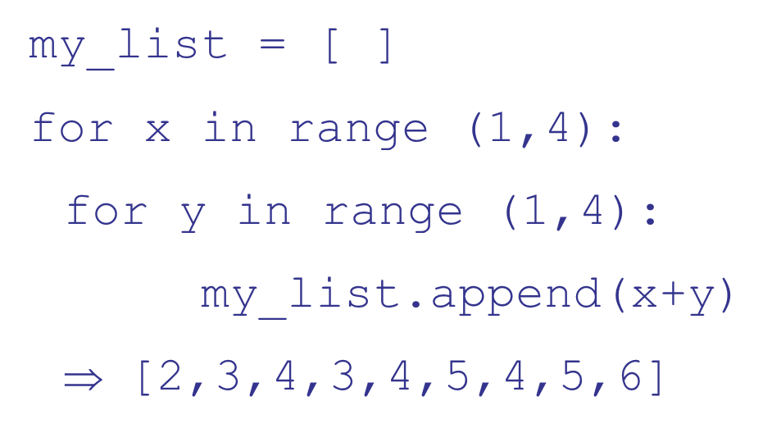
Multiple Collects
It is as if we had done the following:

Slide 71
Modifying What Gets Collected
The if part of the comprehensive controls which of the iterated values is collected at the end. Only those values which make the if part true will be collected
⇒ [‘H’, ‘T’,‘M’]

Slide 72
Reminder, rules so far
Think before you program!
A program is a human-readable essay on problem solving that also happens to execute on a computer.
The best way to imporve your programming and problem solving skills is to practice!
A foolish consistency is the hobgoblin of little minds
Test your code, often and thoroughly
If it was hard to write, it is probably hard to read. Add a comment.
All input is evil, unless proven otherwise.
A function should do one thing.

Slide 73

Copyright

